Slide 1
Proton Plan: Booster Corrector Upgrade
Project Time Line & Current Status
PMG Meeting
September 2006
Craig Drennan

Slide 2
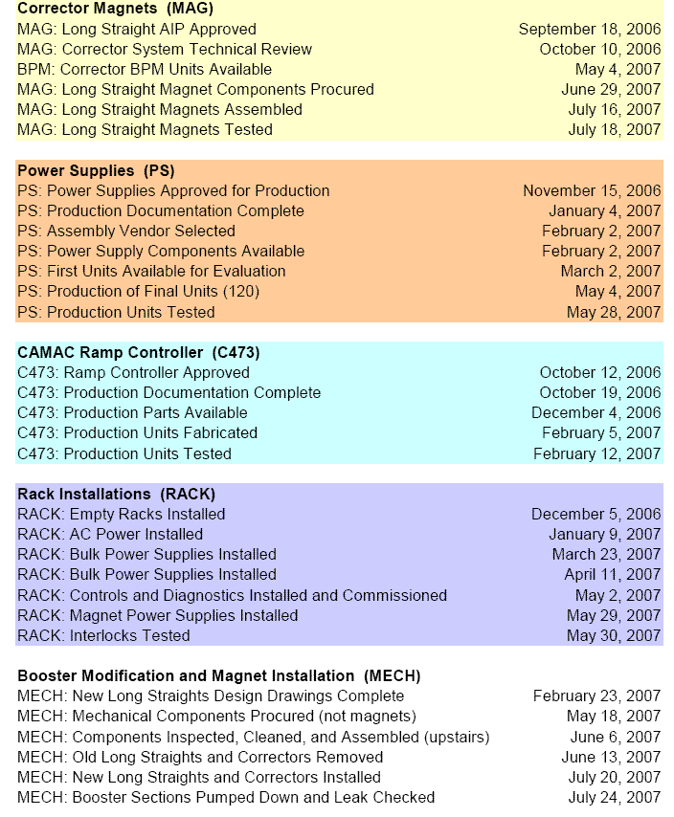
Informal Milestone
Prototype magnet is being tested at MTF
Results being prepared for Oct. 10th technical review.
Final power supply prototypes being fabricated
C473 prototype showing good results.
Initial ACNET application program ready soon.
Cable power tests coming soon
Well into details of designing the new corrector into the long straights.

Slide 3
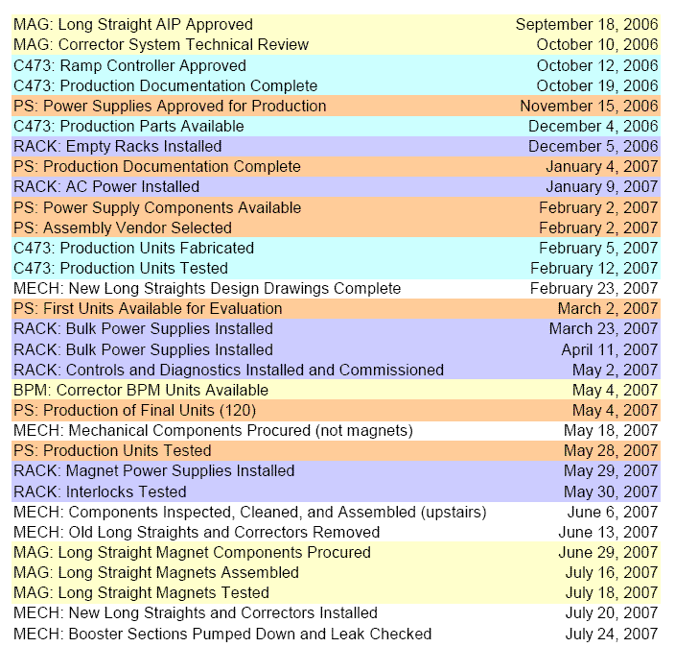
Time Line

